Slide 1
Visual Studio 2022 Overview for C
Opening Visual Studio
Creating a project
Creating a source file
Compilation and execution
Properties and configurations

Slide 2
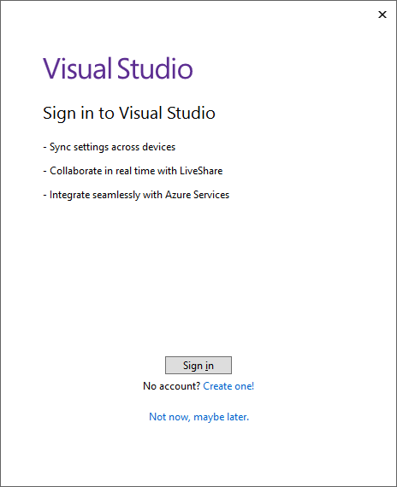
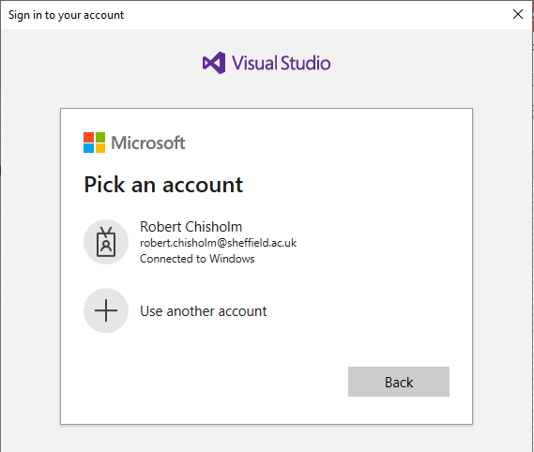
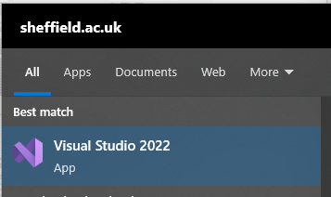
Opening Visual Studio
Select “Visual Studio 2022” from the start menu.
Click “Sign in”
Select your university account from the next window (You don’t need to enter any credentials)

Slide 3
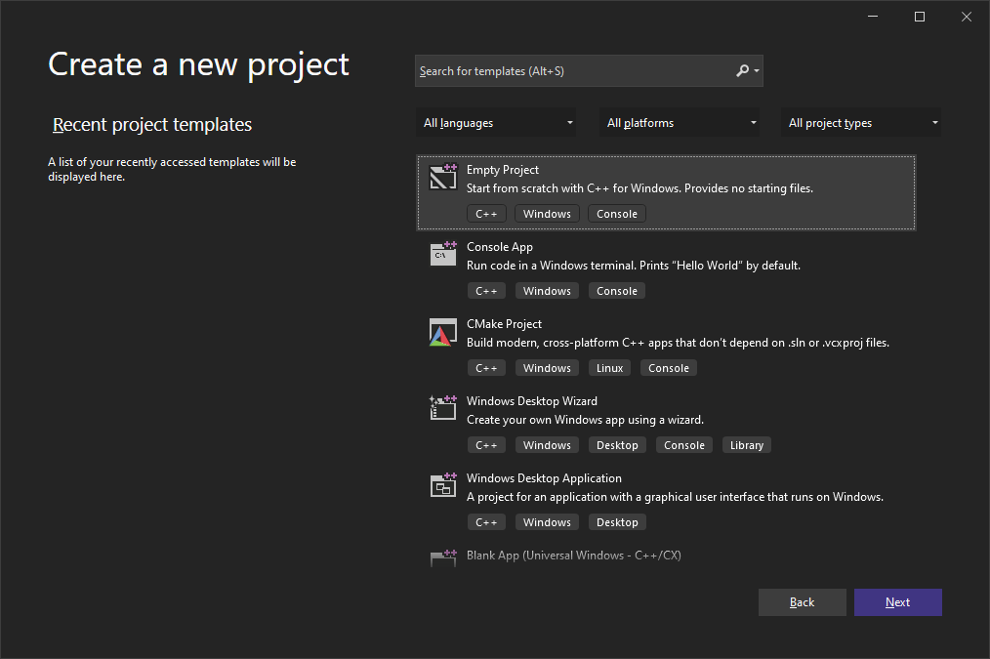
Create New Project
Select “Empty Project” and click Next

Slide 4
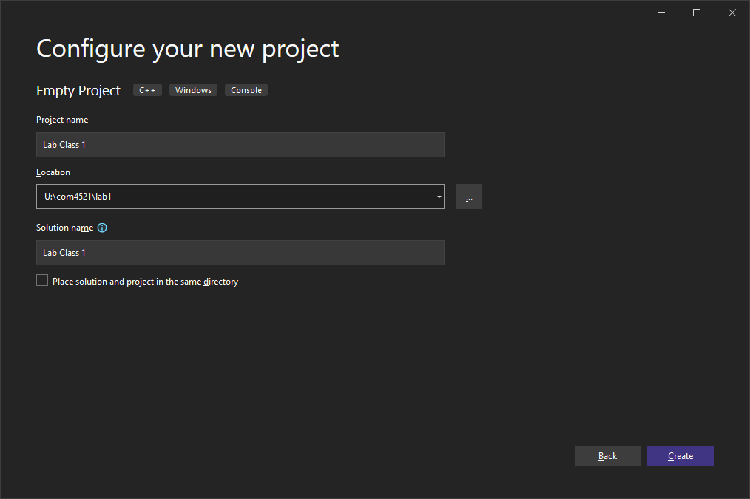
New Project Wizard
Set the location to “U:\” or a subdirectory on this drive and choose a project name and press Create
Storing projects in “\\studata” or other network paths (“\\”) will cause problems when using the CUDA compiler from week 4 onwards!

Slide 5
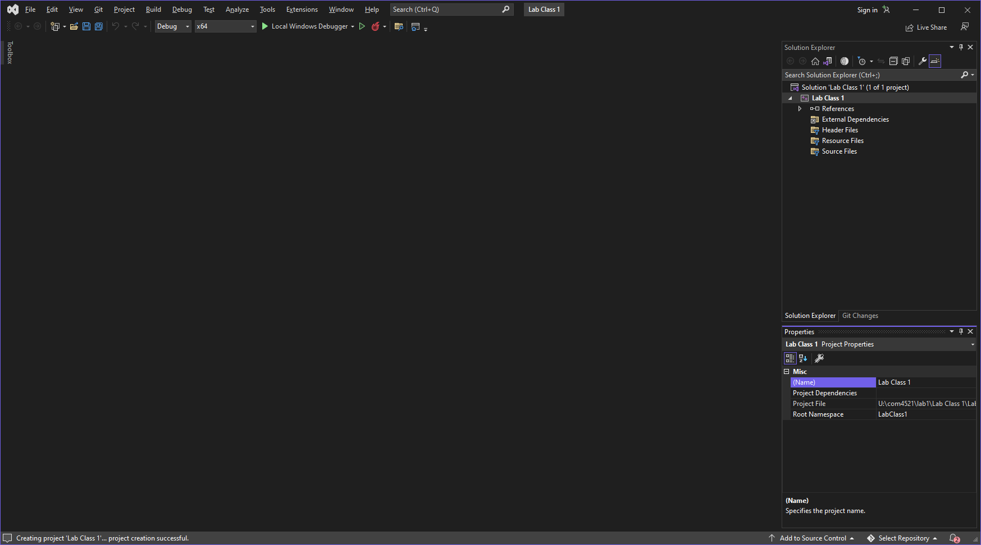

Slide 6
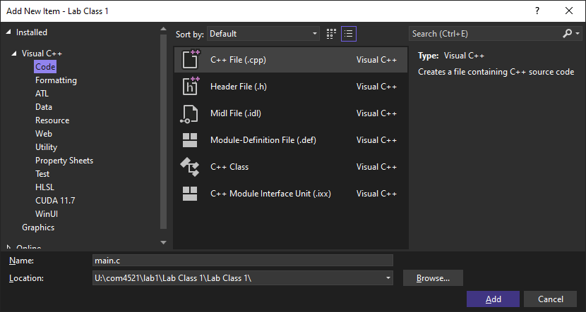
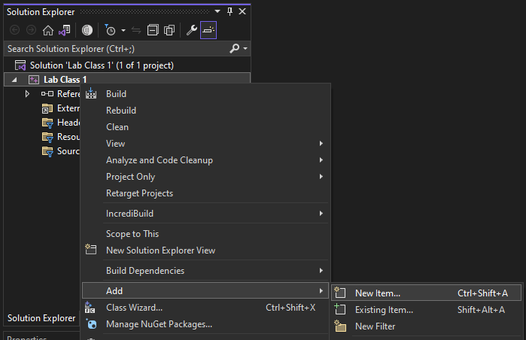
New C file
Right click on project (in solution explorer)
Add ->
New Item…
Name the file .c
A file with .cpp filetype will use the C++ compiler!

Slide 7
Build & Execute
Build
Build->Build Solution
Errors and warning are given in the Output window
Execute
Debug->Start Debugging
You can use the debugging tools to pause the code, and inspect variables.
Debug->Start Without Debugging
The program will execute, ignoring any breakpoints or other debugging features

Slide 8
_CRT_SECURE_NO_WARNINGS
Microsoft have their own safe versions of buffer functions
These are however not cross platform
There are three options to suppress the warning/error:
add _CRT_SECURE_NO_WARNINGS to Project Properties -> Configuration Properties -> C/C++ -> Preprocessor -> Preprocessor Definitions
Items are separated by semicolon (;)
Define the macro before including stdio.h
#define _CRT_SECURE_NO_WARNINGS
#include <stdio.h>
…
Disable the specific warning (with #pragma warning) before including stdio.h
#pragma warning (disable : 4996)
#include <stdio.h>
…

Slide 9
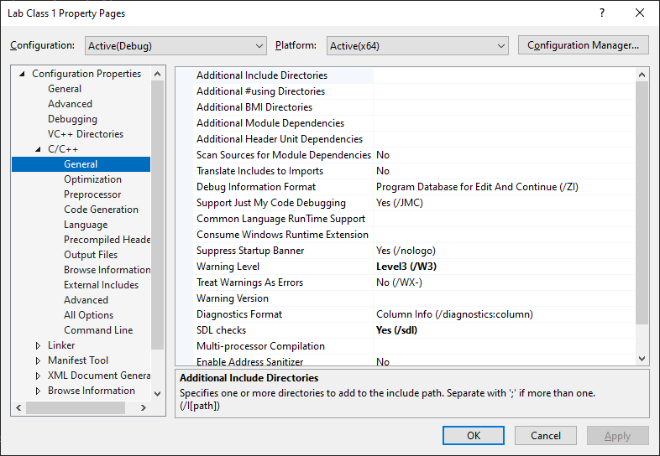
Project/Source module properties

Slide 10
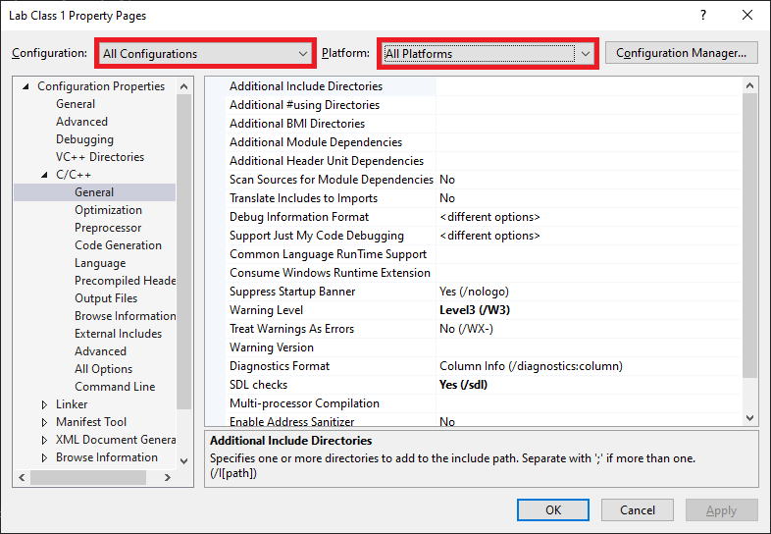
Project/Source module properties
Build configurations can have different properties
As can configuration and platform combinations
Debug
No compiler optimisations
Debug flag
Release
Compiler optimisations
No debug flag

Slide 11
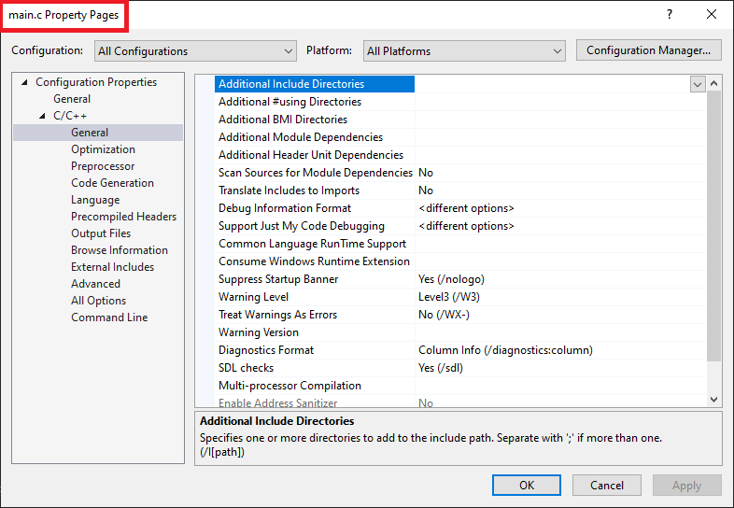
Project/Source module properties
Individual files can also have different properties You will normally want to change properties at a project level for all configurations (and platforms).

Slide 12
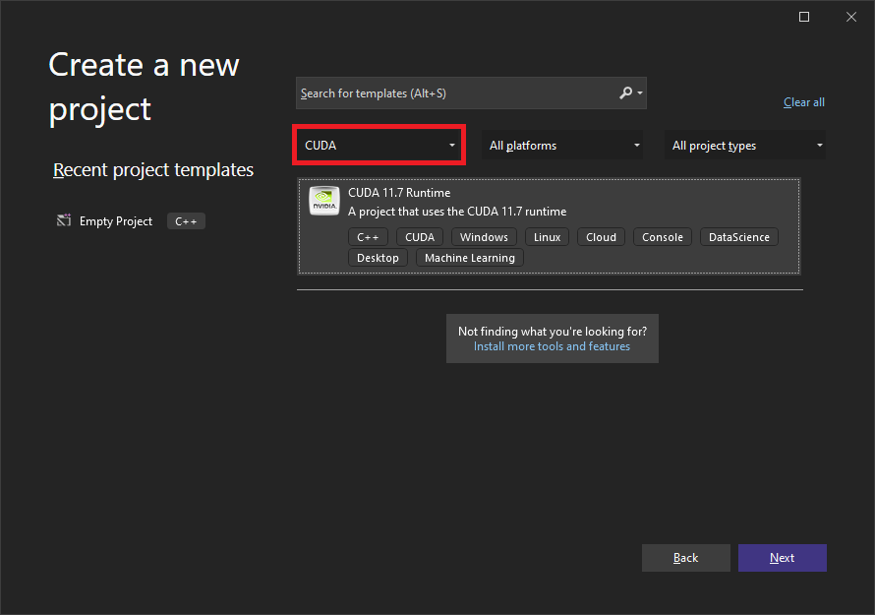
New CUDA Project
Select “CUDA” from the language drop-down.
Select “CUDA 11.7 Runtime” and follow the regular steps. This will enable additional settings required for CUDA.

Slide 13
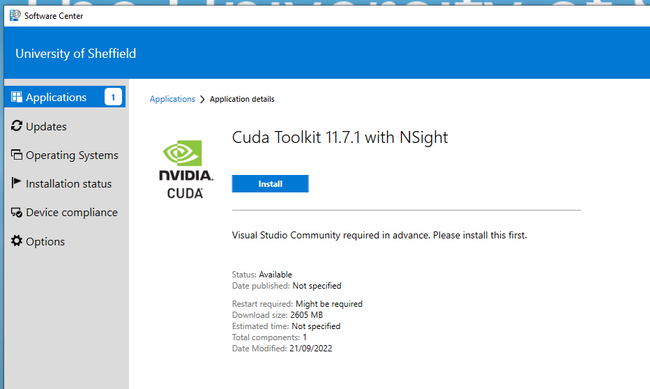

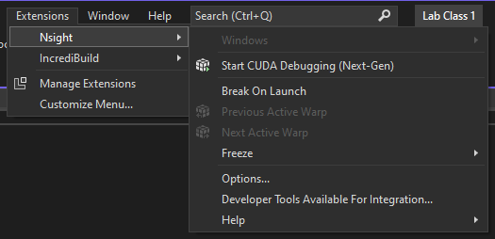
Installing CUDA
As of 2021 the following buildings have computer labs containing machines with GPUs: Heartspace, IC, Hicks, Firth Court, Elmfield.
Unlike in The Diamond, It may be necessary to install (Visual Studio and the) CUDA toolkit on these machines, via the Software Centre, on first use. This may take upto 30 minutes to complete.
Visual Studio MUST be installed before the CUDA toolkit.
When installed, Visual Studio will contain the “Extensions -> Nsight” menu.

Slide 14
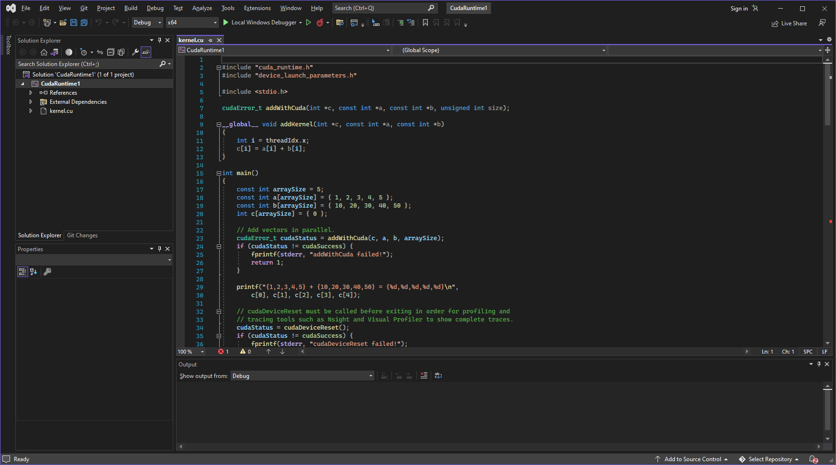
New CUDA projects begin with a sample program “kernel.cu”, this can be deleted, or emptied to use for your own code.

Slide 15

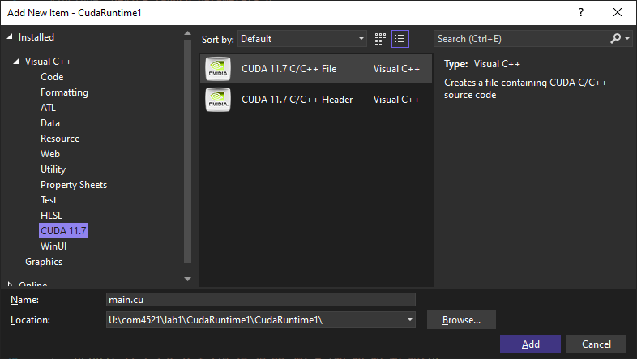
New CUDA file
Open the add new item dialog, and select NVIDIA CUDA in the left menu. Select “CUDA C/C++ File”
If you instead rename a .c file to .cu it won’t be built with the CUDA compiler.

